Slide 1
Design and Development of New Polling System
Viduran Neelakandan
Jayavel Rajan
Akash Suresh
Gaurang Wadhawan

Slide 2
Introduction
The elective polling system is designed to streamline and optimize the process of elective selection for students, ensuring a fair and efficient allocation of seats. In many educational institutions, the current system faces issues such as website crashes due to heavy traffic, unfair seat distribution, and delays in processing student preferences. These challenges lead to frustration among students and administrative inefficiencies.

Slide 3
Abstract
The elective polling system is a cloud-based solution designed to address the challenges faced by educational institutions in managing elective course selections. Traditional systems often suffer from crashes due to high traffic, leading to unfair seat allocation and inefficiencies. This project aims to implement a scalable and reliable system using AWS services, including EC2 for computing, RDS for database management, SQS for queue management, and Cognito for authentication.

Slide 4
Problem Statement
The elective selection process in many educational institutions faces significant challenges, primarily due to system crashes and unfair seat allocation. When students attempt to register for electives simultaneously, traditional web applications fail to handle the sudden surge in traffic, leading to website downtime and frustration.
Additionally, the lack of an efficient queue management system results in some students securing seats unfairly while others are unable to enroll in their preferred courses.

Slide 5
Existing System
In the existing elective polling system used by many educational institutions, students are required to log in and select their preferred electives through a centralized web portal. However, these systems often lack the scalability to handle high volumes of traffic, especially during peak selection hours. As a result, the website frequently crashes or slows down, leading to unfair advantages for students with faster internet connections.
Additionally, there is no real-time feedback on seat availability, and the absence of a queue-based selection mechanism results in some students being locked out or missing their choices altogether. Administrative staff also face challenges due to the lack of automation and transparency in the process.

Slide 6
Proposed System
The proposed system is a cloud-based elective polling platform designed to overcome the shortcomings of the traditional approach. Built on Amazon Web Services (AWS), the system leverages key services such as EC2 for scalable compute resources, SQS for fair and orderly request handling, and RDS for secure data storage. AWS Cognito is used for managing student authentication, while CloudWatch and QuickSight provide real-time monitoring and analytics.
Students can log in, view available electives, select up to three preferences, and confirm their choices. The system ensures fair allocation by processing requests in a managed queue and updates seat availability in real time. This cloud-native design not only enhances performance and reliability but also improves user satisfaction and administrative efficiency.

Slide 7
System Requirements
Hardware:
Processor: Minimum Intel Core i5 or equivalent
RAM: At least 8GB (16GB recommended for better performance)
Storage: Minimum 100GB SSD (Preferably scalable cloud storage)
Internet Connection: Stable high-speed internet for cloud interactions
Server Requirements: AWS EC2 instances with auto-scaling capabilities
Load Balancer: AWS Elastic Load Balancer for traffic distribution

Slide 8
Software:
Operating System: Windows 10/11, macOS, or Linux
Programming Languages: Python, JavaScript (Node.js), SQL
Frameworks & Libraries: React.js (Frontend), Express.js (Backend), AWS SDK
Database: AWS RDS (MySQL/PostgreSQL)
Cloud Services: AWS EC2, AWS RDS, AWS SQS, AWS Lambda, AWS ElastiCache, AWS Cognito
Monitoring Tools: AWS CloudWatch and AWS QuickSight for analytics
Version Control: GitHub or GitLab for source code management
Deployment Tools: AWS CodePipeline, AWS CodeDeploy for CI/CD integration

Slide 9
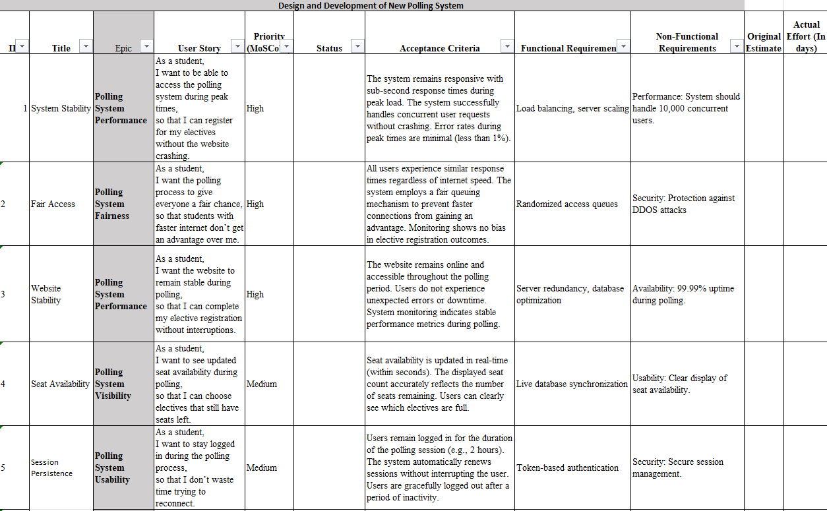
Product Backlog

Slide 10
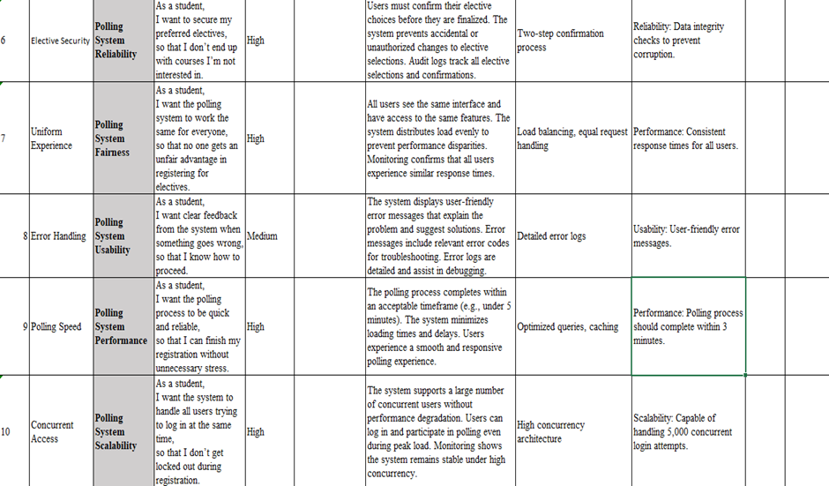

Slide 11
Sprint Overview
Sprint 1: Core System Stability & Fair Access
User Stories: 1, 3, 7, 10
Sprint 2: Real-Time Interaction & Session Handling
User Stories: 2, 4, 5, 9
Sprint 3: Confirmation, Feedback, and Waitlisting
User Stories: 6, 8, 11, 12

Slide 12
Sprint 1: Core System Stability & Fair Access
Objectives :
Ensure the system can handle peak loads without crashing
Guarantee fair access to all users regardless of internet speed
Establish a stable foundation for future features
Activities:
Designed a scalable backend using Node.js and Express
Integrated MongoDB for secure and fast data storage
Implemented session management to keep users logged in
Used load balancing techniques to distribute traffic
Ensured polling requests are processed in a fair sequence

Slide 13
Sprint 2: Real-Time Interaction & Session Handling
Objectives:
Improve user interaction and feedback during elective selection
Handle login session management and persistence
Update seat availability dynamically for better decision making
Activities:
Added dynamic seat availability using frontend updates from backend data
Ensured users stay logged in through polling completion
Optimized the polling submission process for speed
Enhanced UI/UX responsiveness with proper error handling

Slide 14
Sprint 3: Confirmation, Feedback, and Waitlisting
Objectives:
Provide clear feedback and confirmation to users after polling
Add functionality to waitlist users when electives are full
Notify students about successful registrations
Activities:
Created a confirmation screen after successful polling
Saved selected electives to MongoDB for each user
Implemented a waitlist option when elective limits are exceeded
Displayed final selected electives with feedback messages
Added a simple notification mechanism (alerts) post-registration

Slide 15
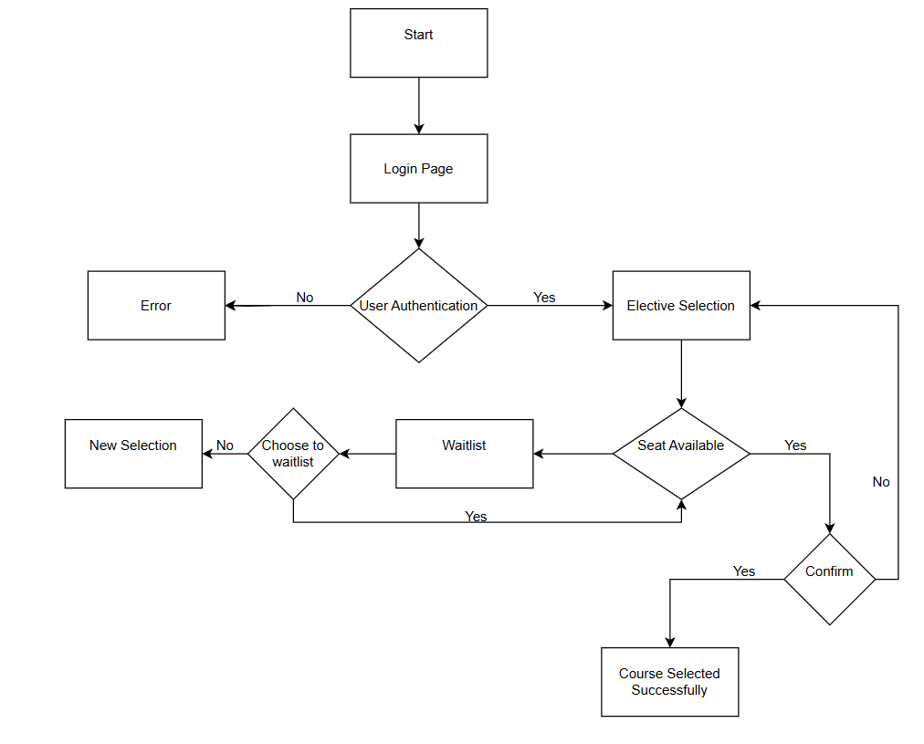
System Architecture

Slide 16
It describes the procedures from user login to waitlisting or elective confirmation. Important choices like seat availability, confirmation handling, and authentication are all part of the flow. Additionally, it handles situations where all seats are taken by providing a waitlist or requesting a new selection. All users are guaranteed a seamless, dependable, and equitable registration process as a result.
The user must successfully complete authentication on the Login Page to start the process.The process terminates and an error message appears if authentication is unsuccessful.The student moves on to elective selection if they are successful.

Slide 17
The system verifies seat availability for the selected subject once it has reached the Elective Selection page.The student is asked to confirm their selection if there are seats available.The course is marked as successfully selected if it is verified.
Students are given the option to join a waitlist if the elective is full.Their entry is noted appropriately if they decide to add themselves to the waitlist.They are asked to choose again if they don't

Slide 18
Advantages
Scalability :The system can handle a large number of users by distributing traffic through a load balancer and queue management system.
Reliability :With session management and distributed servers, the polling website ensures uninterrupted service.
Efficient Request Handling :The queue management system prevents system crashes by processing requests in an organized manner.
Real Time Notifications :Users receive timely updates through the notification system
.Data Insights :Logs and analytics help in monitoring user behavior and system performance for future improvements.

Slide 19
Disadvantages
Infrastructure Cost :Implementing load balancing, queue management, and analytics requires significant cloud resources.
Complexity :Managing multiple services and integrations increases system complexity.
Latency Issues :Queueing requests may introduce slight delays in processing.
Security Risks :User authentication and session management must be robust to prevent data breaches.
Dependency on Cloud Services :System performance relies on cloud provider availability and pricing.

Slide 20
Futurework
Future enhancements to the elective polling system could include the integration of AI-based recommendation engines that suggest electives based on a student’s academic history or interests. A role-based admin panel can be added for staff to manage courses, view real-time analytics, and override entries when needed. Additionally, integrating blockchain technology could ensure data immutability and secure record-keeping of student choices. The system can also be expanded to support mobile platforms and multi-lingual interfaces for broader accessibility. As the system matures, implementing real-time waitlists and automated conflict resolution between elective schedules can further streamline the process.

Slide 21
Conclusion
The proposed elective polling system architecture enhances reliability, scalability, and fairness in seat allocation. By integrating load balancing, queue management, caching, and real-time notifications, it prevents crashes and ensures smooth operation during peak usage. The system's analytics and monitoring components help optimize performance and user experience. Implementing this system on AWS provides a robust and scalable solution, making elective selection more transparent and efficient for students.

Slide 22
References
Amazon Web Services (AWS) Documentation - https://aws.amazon.com/documentation/
Load Balancing in Cloud Computing, IEEE Journals
Queue Management Systems: Best Practices, ResearchGate
Best Practices for Scalable Web Applications, ACM Digital Library
Cloud-Based Voting and Polling Systems, Springer Publications

